Slide 1
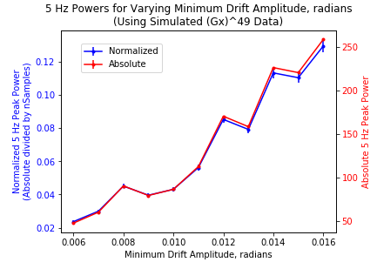
Varying the amplitude of a single 5 Hz drift oscillation

Slide 2
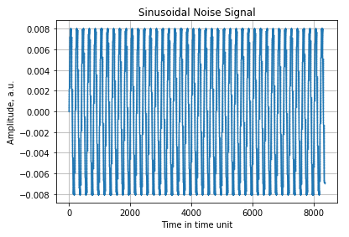
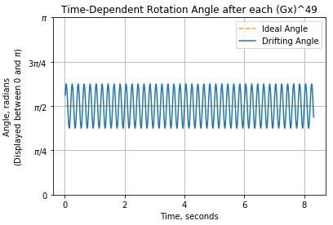
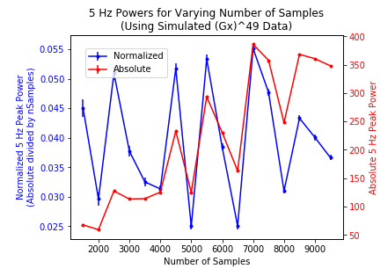
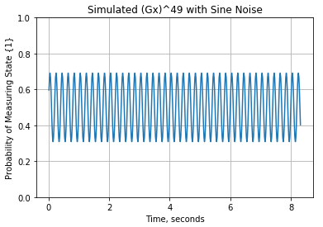
Varying the number of samples for a 5 Hz, 0.008 amplitude oscillation with Gx49

Slide 3
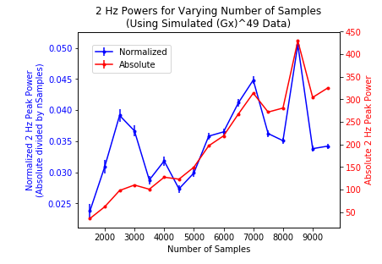
Same settings, except I changed the frequency to 2 Hz.
It still seems to center around 0.04 at longer samples…This may be because 2 Hz takes longer to appear in time.
I want to try plots like these but with more trials per set of parameters. Are these wide fluctuations in normalized power just statistical and do they averaged out to something meaningful?

Slide 4
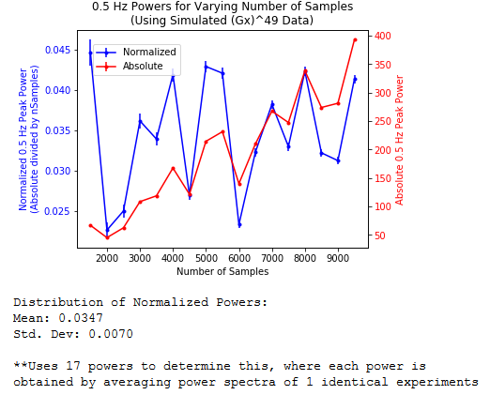
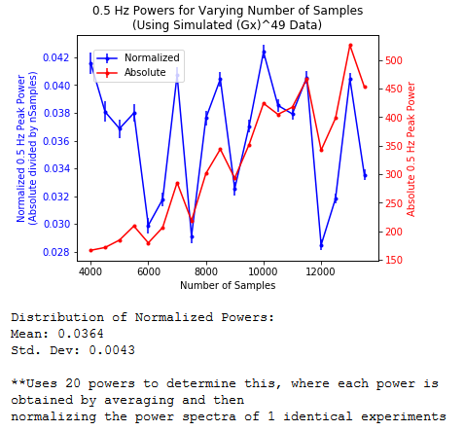
Lowered down to 0.5 Hz. The normalized power again seems to stabilize some more a longer sample numbers.

